Slide 1

Practical Lecture
Software Design and Architecture
Rana Taimur Khan
Lecturer GCUF

Slide 2
Data Flow Diagrams

Slide 3
DFD The Notation

Slide 4
DFD - The Notation
Process
External
Agent
Data Store

Slide 5
DFD versus Flow Charts

Slide 6
DFD versus Flow Charts
Processes on a data flow can operate in parallel.
Looping and branching are typically not shown.
Each process path may have a very different timing.
Processes on flowcharts are sequential.
Show the sequence of steps as an algorithms and hence looping and branching are part of flowcharts.

Slide 7
DFD Example
Reconcile
Account
Balance
Deposit
Funds into
an Account
Other
Income
Sources
Monthly
Acct Stmt
Bank
Accounts
Employer
Account
Transactions
Withdraw
funds from
an Account
Pay
a
Bill
Bank
Creditor

Slide 8
What to Show?

Slide 9
Levels of Abstraction

Slide 10
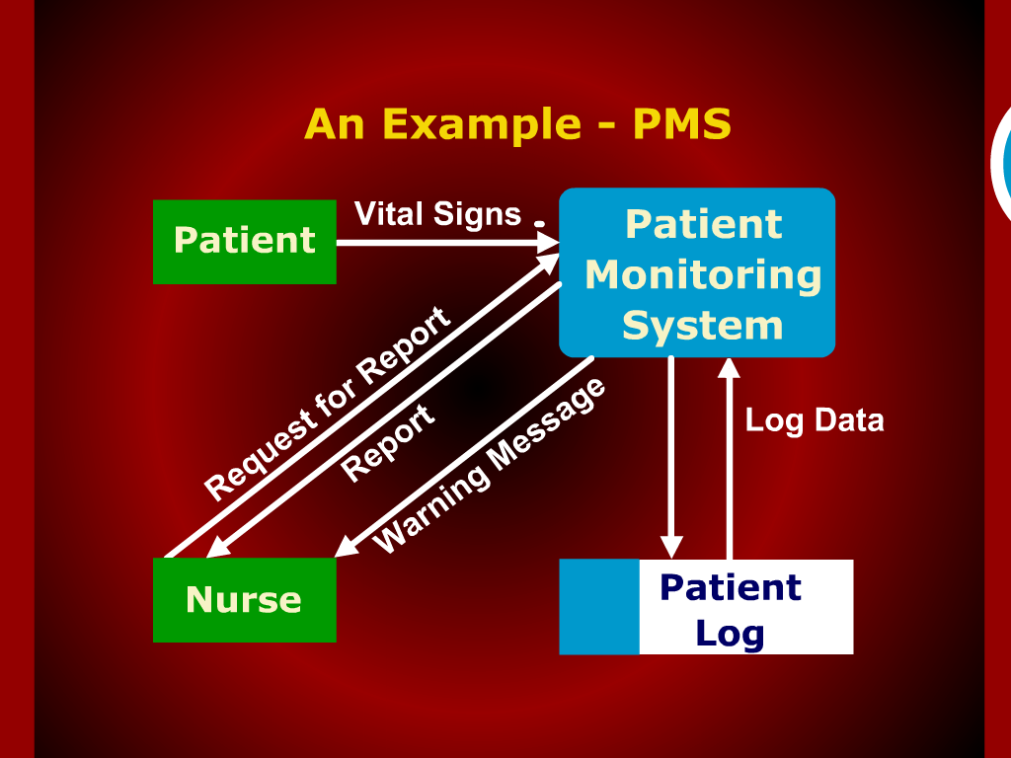

Slide 11
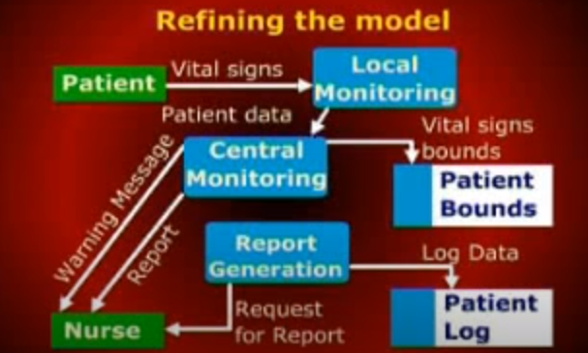

Slide 12
